Slide 1
Lineair - schikking
Integrale opdracht
Schaalschikking in stijl

Slide 2

Lineair schikking

Slide 3

Lineair schikking

Slide 4
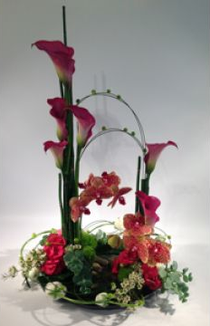

Lineair schikking

